Slide 1
OVERVIEW OF THE NATIONAL HEALTH ACT & ITS IMPLICATIONS
A PRESENTATION DELIVERED BY:
DR. OSAHON ENABULELE, MBBS, MHPM, FWACP
Consultant Family Physician;
Vice President, Commonwealth Medical Association;
Immediate Past President, Nigerian Medical Association.
AT THE 2015 MEDICAL CONFERENCE OF
ACE MEDICARE CLINICS LTD
DATE: TUESDAY, 15th DECEMBER, 2015.
VENUE: COVENANT UNIVERSITY, OTA, OGUN STATE.

Slide 2
OUTLINE
PROTOCOL
SETTING THE SCENE---UNRAVELING THE BASIS FOR THE LECTURE.
OBJECTIVES OF THE LECTURE.
INTRODUCTORY DEFINITION OF TERMS.
BASIS AND QUEST FOR NATIONAL HEALTH ACT (NHA).
HISTORICAL PER-EGRINATION OF THE NHA.
FORM AND NATURE OF THE NHA.
ESSENTIAL FEATURES/RAMIFICATIONS OF THE NHA.
IMPLICATIONS OF THE NHA.
RECOMMENDATIONS.
CONCLUSION.

Slide 3
SETTING THE SCENE
UNRAVELING THE BASIS FOR THE LECTURE.
What informed the choice of the theme?

Slide 4
OBJECTIVES OF THE LECTURE
To create awareness of the National Health Act.
To enlighten participants on the essential features/ramifications and implications of the National Health Act.
To inspire participants to join other stakeholders in the committed implementation of the National Health Act.

Slide 5
INTRODUCTORY DEFINITION OF TERMS
National
According to the Oxford Advanced Learner’s Dictionary, International Student’s Edition, New 8th Edition, the term National refers to:
--- Something shared by a whole nation or something connected with a particular nation.
WHAT IS HEALTH?
‘A state of complete physical, mental and social wellbeing, and not merely the absence of disease or infirmity’.
-----WHO; 7th April,1948

Slide 6
What is an Act?
A piece of legislation enacted by a country’s representative body.
What is a Constitution?
An embodiment of the laws and principles by which a nation, state, or organizations are governed.

Slide 7
BASIS FOR THE NHA
Health is fundamental
Challenges faced by Nigeria’s Health System: Routine Immunization (2009-6.3B; 2014-2.5B); MSS (2009-3.6B; 2014-1.4B)
No significant provision in the 1999 constitution
Need to be in league with other countries with Legal framework for health.
National Health Act will facilitate the advancement of the Fundamental Health Rights of Nigerians, expansion of Universal Health Coverage for the long toiling and pauperized people of Nigeria, standardization of health infrastructure and health human resource development.

Slide 8
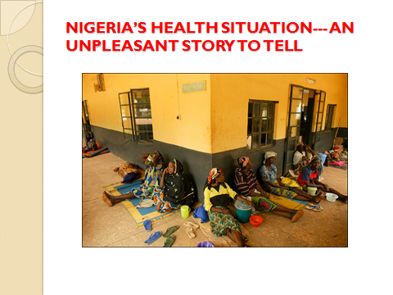

Slide 9

NIGERIA’S HEALTH SITUATION--- AN UNPLEASANT STORY TO TELL

Slide 10

NIGERIA’S HEALTH SITUATION--- AN UNPLEASANT STORY TO TELL

Slide 11

NIGERIA’S HEALTH SITUATION--- AN UNPLEASANT STORY TO TELL

Slide 12

NIGERIA’S HEALTH SITUATION--- AN UNPLEASANT STORY TO TELL

Slide 13
NIGERIA’S HEALTH SITUATION--- AN UNPLEASANT STORY TO TELL
The doleful performance of Nigeria’s healthcare sector despite immense intellectual capital, like other sectors of the country’s economy, is no longer news.
Nigeria’s political leaders find it very convenient to travel abroad, under government sponsorship, in search of medical care for basic medical conditions. What a monumental shame and tragedy of immense proportions!
Nigeria losses over $1 billion dollars to medical tourism.

Slide 14
NIGERIA’S HEALTH SITUATION--- AN UNPLEASANT STORY TO TELL
Annually, Nigerians spend about $1 billion on healthcare in foreign hospitals, largely due to thousands of medical visas issued annually by the Indian High Commission (as at 2012/2013).
In the year 2000, WHO (in its World Health Report) ranked Nigeria 187 out of 191 member countries in terms of health system performance.

Slide 15
NIGERIA’S HEALTH SITUATION--- AN UNPLEASANT STORY TO TELL
Nigeria constitutes 2% of the world population but she accounts for about 10% of global child mortality and about 14% of global maternal mortality.
High Infant Mortality Rate: 69/1000 live births (NDHS 2013).
Under-5 Mortality Rate: 128/1000 live births (NDHS 2013)
A million children die every year.

Slide 16
NIGERIA’S HEALTH SITUATION--- AN UNPLEASANT STORY TO TELL
High Maternal Mortality Rate: 576/100,000 live births (NDHS 2013); one of the highest in the world---10 plane loads of pregnant women crashland weekly during delivery
Life Expectancy at Birth: Male(47.3yrs; now 51.63); Female (48.3yrs; now 53.66yrs); average in LDC countries is 53 years; 2004 NDHS put LEB at 52.2 years.

Slide 17
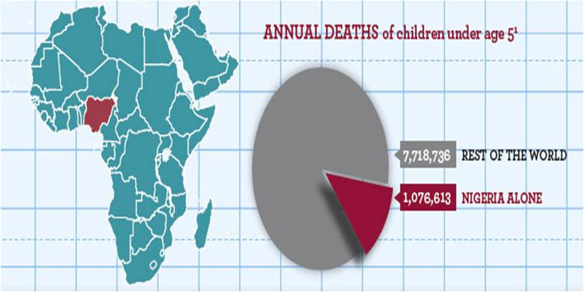
NIGERIA’S HEALTH SITUATION--- AN UNPLEASANT STORY TO TELL

Slide 18
NIGERIA’S HEALTH SITUATION--- AN UNPLEASANT STORY TO TELL
Per-capita expenditure on health: ≤ $12 per-capita.
Out-Of-Pocket Expenditure on health: >69% of total HE.
Poor Access to HC (37%).
Skilled attendance at birth: 38%; NDHS 2013 (↓42%).
Delivery in Health facilities: 36% (NDHS 2013).

Slide 19
NIGERIA’S HEALTH SITUATION--- AN UNPLEASANT STORY TO TELL
High rate of Road Traffic Accidents—2nd on WHO weighted scale of countries.
Nigeria has 2nd highest number of HIV infected persons in Africa.
Growing burden of Non-Communicable Diseases

Slide 20
NIGERIA’S HEALTH SITUATION--- AN UNPLEASANT STORY TO TELL
Cumulative years of military misadventure in governance, political instability, policy inconsistency and poor governance.
Poor political commitment to health.
Poor funding and budgetary provisions for health.
Average sectoral allocation to the health sector at the federal level from 2009 to date: 5.34%.
2009(4.3%); 2010(3.7%); 2011(5.4%); 2012(6%); 2013(6.04%); 2014(5.7%); 2015(5.4%).

Slide 21
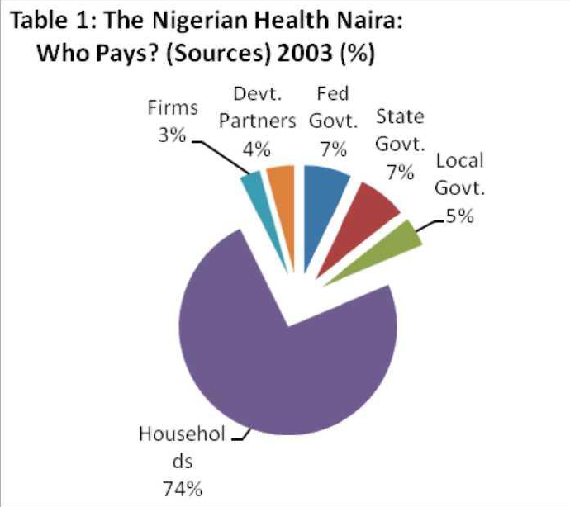
Health expenditure patterns
(Data from National Health Accounts 2003)

Slide 22
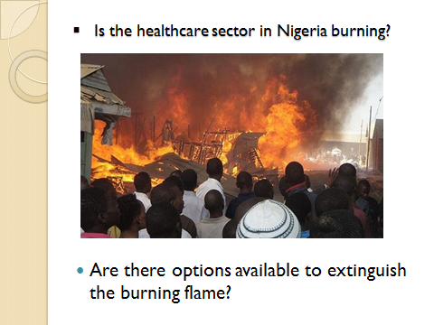

Slide 23
HISTORICAL PER-EGRINATION OF THE NHA
A Tortuous Journey
1964 advocacy by NMA
2002—CAP/ Herfon; Nigeria was 187/191 countries by WHO.
2004 – Production of 1st Draft Executive Bill
Harmonization of versions; ---Processing of bill by the Senate.

Slide 24
May 19, 2011 – Both houses of the 6th Assembly passed the NHB following series of protests, but presidential assent was not given.
2012 – Recommencement of struggle with 7th Assembly
Monday Feb. 11, 2013 - Public hearing by Senate Committee on Health with unprecedented mobilization for passage of NHB 2012 by NMA.
Oct. 8, 2013 – President Goodluck Jonathan (GCFR) makes firm promise to NMA under my leadership.
19th February, 2014 – Senate passes NHB 2012 after 3rd reading.
HOR follows same path.
Sep. – Oct. 2014 – Harmonization of versions
Dec. 9, 2014 – Presidential assent at last
NHB transformed to NHA.

Slide 25
FORM & NATURE OF THE NHA
A 47 page document
7 Parts
65 Sections

Slide 26
ESSENTIAL FEATURES OF THE NHA
Part 1--RESPONSIBILITY FOR HEALTH AND ELIGIBILITY FOR HEALTH SERVICES AND ESTABLISHMENT OF NATIONAL HEALTH SYSTEM
S1(1)
Established for the Federation the National Health System which shall define & provide a framework for standards & regulation of health services
The National Health System embraces both public & private providers of health services
is expected to promote a spirit of co-operation & shared responsibility among all health care providers in the Federation

Slide 27
ESSENTIAL FEATURES (CONT’D)
Part 1
S1(1)
Is to provide for persons living in Nigeria the best possible health services within the limits of available resources.
Sets out the rights & obligations of users, health care, health providers & health establishments
Is expected to protect, promote & fulfill the rights of all Nigerians to have access to a basic minimum package of health care services S3(3)
Fundamental right to health; vs chap 2 of 1999

Slide 28
ESSENTIAL FEATURES (CONT’D)
Part 1
S1(2)
Aside from incorporation of the traditional health authorities at the various levels of Government, the NHA incorporates: Ward Health Committees, Village Head Committees, Private Healthcare providers, Traditional Healthcare providers & alternative Healthcare providers.
Part 1 (S2(1)) also defines the responsibilities of the Federal Ministry of Health (e.g.)
Development of National health policy & issuance of guidelines for its implementation

Slide 29
ESSENTIAL FEATURES (CONT’D)
Part 1
S1(2)
Collaboration with States & LGAs in the implementation of the national health policy
Collaboration with national health Departments of other countries & International agencies
S2(1)i – The FMoH has a defined role for provision of tertiary & specialized hospitals as well as inter-sectoral & inter-ministerial collaboration

Slide 30
ESSENTIAL FEATURES (CONT’D)
Part 1
S2(1)e –FMoH is now legally required to monitor & analyze the health status of Nigeria and the performance of the National health system, as well as submit an annual report of the state of health of Nigerians to the President and National Assembly (S2(2)d)

Slide 31
ESSENTIAL FEATURES (CONT’D)
Part 1
S2(2)
Preparation of Annual Strategic medium-term National Health & human resource plans in conformity with the National health policy, from which the annual budget of the Ministry is to be derived.
S3(1)
Defines conditions subject to which categories of persons may be eligible for exemption from payment for health care services at public health establishments

Slide 32
ESSENTIAL FEATURES (CONT’D)
Establishment of National Council on Health (S4(1)) & the Technical Committee of the Council (S6(1)).
Representatives of registered Health professional associations, Traditional medicine Practitioners & alternative health care providers will now be legal members of the Technical Committee (S6(2)j)
S9(1) Established the National Tertiary Health Institutions Standards Committee, to amongst other functions, evaluate all activities and receive annual reports from tertiary hospitals, as well as supervise annual peer reviews.

Slide 33
ESSENTIAL FEATURES (CONT’D)
S11 - Established The Basic Health Care Provision Fund (BHCPF) to be sourced from the Federal Government (1% of CRF), International Donor Partners and other sources.
BHCPF is to be utilized as follows;
50% for provision of basic minimum package of health care services for eligible primary and secondary health care facilities through the NHIS (demand s)
20% for essential drugs, vaccines and consumables for eligible PHC facilities
15% for provision and maintenance of facilities, equipment and transport for eligible PHC facilities
10% for provision of Human resources for eligible PHC facilities
5% for emergency medical treatments

Slide 34
ESSENTIAL FEATURES (CONT’D)
PART 1I--HEALTH ESTABLISHMENTS AND TECHNOLOGIES
Sets out the process for regulating health establishments and technologies as well as setting standards and quality requirements for health establishments.
S12(1) – All health establishments are to be classified according to regulations prescribed by the Minister
S13(1) – necessity for a Certificate of Standards without which no public or private health establishment or NGO can render health care services.

Slide 35
ESSENTIAL FEATURES (CONT’D)
PART 11
S13(1)d – Gives a grace period of two years from the date the Act took effect
S14 – prescribes a fine of not less than #500,000:00k or imprisonment for two years for violators
S15(1)b – defines mechanisms for public hospitals to retain a percentage of their IGR

Slide 36
ESSENTIAL FEATURES (CONT’D)
PART 11I--RIGHTS AND OBLIGATIONS OF USERS AND HEALTHCARE PERSONNEL
S20 (1) – makes it incumbent on a health worker, healthcare provider or health establishment to offer emergency medical treatment to all persons.
S20(2) – prescribes a fine of N100,000:00k or 6 months imprisonment for violators.
S21 – defines the rights of health workers & health care providers, including refusing to treat a user who is physically or verbally abusive or who sexually harrasses him or her; but the health provider must report the case to the appropriate authority
Exception: Psychiatric patients.

Slide 37
ESSENTIAL FEATURES (CONT’D)
PART 11I
S22 – defines the right of the health worker to be idemnified against liabilities where he or she is not negligent
S23 – makes it incumbent for health care providers to offer the users, relevant information on his health status & planned treatment.
S24 – Makes it incumbent for health facilities to display basic information at facility level as well as procedures for laying complaints.

Slide 38
ESSENTIAL FEATURES (CONT’D)
Part 111 also defines the need for appropriate health record keeping retrieval, access and confidentiality of patient information/health records
S30(1-4) defines the right of the patient to lay complaints, as well as the procedure to be followed by the patient.
Part III also prescribes a fine of N250, 000 : 00k and/or imprisonment of 2 years for violators of patients confidentiality.

Slide 39
ESSENTIAL FEATURES (CONT’D)
PART IV--NATIONAL HEALTH RESEARCH AND INFORMATION SYSTEM
Establishes the National Health Research Committee (13 members) as well as the National Health Research Ethics Committee (15 members) by the Health Minister
With Reflection of Federal character in the membership of the national health research Committee (S31(3))
S32 – Defines conditions to be observed for conduct of research or experimentation with human subjects, including minors (for therapeutic or non-therapeutic purposes).

Slide 40
ESSENTIAL FEATURES (CONT’D)
PART IV
S35 – Defines the need for a National Health Management Information System (NHMIS) at all levels of the healthcare system, including FCT and private health establishments.
S37(1)b – Prescribes the establishment of a HMIS by private health care providers as a condition for the grant or renewal of the Certificate of Standards.
S37(2) – prescribes a fine of N100,000:00k or imprisonment of 6 months for private health care providers who fail to comply

Slide 41
ESSENTIAL FEATURES (CONT’D)
PART IV
S39 – defines the need for an Essential Drug list and National Drug Formulary, both of which are to be periodically reviewed.
S40 – Expresses the responsibility of the National Council on health to spread the NHIS to all catchment areas and parts of the Federation.

Slide 42
ESSENTIAL FEATURES (CONT’D)
PART V – Human Resources for Health
Defines the need for Health Human Resource Manpower Development Plans at all levels including strategies for the recruitment, retention, efficient utilization and distribution of health manpower within and outside Nigeria.
S43(b) – Prescribes re-certification programme for health workers through CPDs.
S45(1) – Classifies Health services as Essential Service subject to the provisions of the relevant law.

Slide 43
ESSENTIAL FEATURES (CONT’D)
PART V – Human Resources for Health
S45(2) – Views industrial disputes in the public health sector as one that should be handled seriously without allowing for total disruption of health service delivery in public health institution.
S45(3) – gives powers to the Minister to apply all reasonable measures to restore normalcy within 14days of the occurrence of the disruption.

Slide 44
ESSENTIAL FEATURES (CONT’D)
PART V – Human Resources for Health
S46 – Restricts Medical treatment abroad for public officers to only exceptional cases referred for the Minister’s approval by the Medical Board.
‘’Without prejudice to the right of any Nigerian to seek medical check-up, investigation or treatment anywhere within and outside Nigeria no public officer of the government of the Federation or any part thereof shall be sponsored for medical check-up, investigation or treatment abroad at public expense except in exceptional cases on the recommendation and referral by the medical board and which recommendation or referral shall be dully approved by the Minister or the Commissioner of health of the state as the case may be.’’

Slide 45
ESSENTIAL FEATURES (CONT’D)
PART VI--CONTROL OF USE OF BLOOD, BLOOD PRODUCTS, TISSUE AND GAMETES IN HUMANS
Establishes a National Blood Transfusion Service
Defines conditions under which organs, tissues blood and blood products may be removed on transplanted
Establishes the need for involved health establishments to set up Independent Tissue Transplantation Committee
S51 & S52 – Confers the right to remove and transplant a tissue in a living person on only medical & dental practitioners

Slide 46
ESSENTIAL FEATURES (CONT’D)
PART VI
S58 – Prescribes conditions for the conduct of post mortem examination of the body of a deceased person.

Slide 47
ESSENTIAL FEATURES (CONT’D)
PART VII--REGULATIONS AND MISCELLANEOUS PROVISIONS
S59 – Gives powers to the Minister to make further regulations in furtherance of the implementation of the Act.
S60 – gives powers to the Minster to establish such number of advisory and technical committees as may be necessary to achieve the objects of the Act.
S61(1) – Gives power to the Minister to establish a National Consultative Health Forum

Slide 48
ESSENTIAL FEATURES (CONT’D)
S64 - Interpretation clause
S65 – Citation: This Act may be cited as the National Health Act, 2014.

Slide 49
NHA & ITS IMPLICATIONS
EQUITY & ELIGIBILITY OF NIGERIANS TO ACCESS HEALTHCARE SERVICES
The NHA in Section 1 (1,c) provides that the National Health System ‘’shall provide for persons living in Nigeria the best possible health services within the limits of available resources.’’
It goes further in Section 1 (1,e) to state that the National Health System shall protect, promote and fulfil the rights of the people of Nigeria to have access to healthcare services.’’
Additionally, the NHA provides in Sections 3(3) and 15(3) that all Nigerians shall be entitled to a basic minimum package of health services.
IMPLICATIONS
i) These provisions clearly make the right to health justiciable. Therefore, the citizens of Nigeria can seek for the concrete legal expression of their health rights whenever deprived.
ii) However, as part of the implementation framework, there will be need to define the full range and constituent elements of the basic minimum package of health care intended by the NHA.
iii) It would also require improved budgetary allocations to the health care sector.

Slide 50
REGULATION, STANDARDIZATION & QUALITY OF HEALTH INFRASTRUCTURE AND SERVICES
For the first time in the legal lexicon of Nigeria there are now provisions compelling the regulation and standardization of Nigeria’s National Health system as well as the enthronement of quality. In particular, the NHA now imposes a legal requirement for setting up public and private health facilities through their classification (S 12 (1) a) and compulsory acquisition of a Certificate of Standards (S 13 (1) a, b, c, d).
Remarkably, by virtue of Section 13 (1 (a, b, c, d) ), all owners of public and private health facilities have a grace period of two years (counting from the day the Act took effect) to acquire a Certificate of Standards, failing which they will be barred from operating the health facility.
All health establishments are expected to comply with the quality requirements and standards prescribed by the National Health Council (Section 19 (1 & 2)).
Furthermore, the NHA provides for a National Tertiary Health Institutions Standards Committee (Sections 9 & 10) to ensure standards and quality in our tertiary health institutions, as well as supervise annual peer reviews.

Slide 51
POLITICAL COMMITMENT TO HEALTH
Aside from making it mandatory for the Nigerian Government to commit a minimum of 1% of the Consolidated Revenue Fund to the health sector (S11, 2, a), the NHA makes some delineation in roles and responsibility for health by the various levels of government.
For instance, Section 2(1,i) makes it incumbent for the Federal Ministry of Health to provide tertiary and specialized hospital services, while in Section 15 (1) the responsibility to provide secondary health care services at public health establishments within the state is reserved for the State Government or the appropriate State authority.
As earlier stated, the NHA obligates the Nigerian state to protect and promote the right of Nigerians to seek health care services as in Section 1 (1, e).
It also makes legal provisions for the exemption of some categories of Nigerians from payment for healthcare services rendered by public health establishments (S 3, 1; and S 15, 2), while making it incumbent on the Nigerian state to mandatorily provide for the healthcare needs of vulnerable groups such as women, children and the elderly (S3, 2d).

Slide 52
FINANCING HEALTH CARE AND UNIVERSAL HEALTH COVERAGE
Perhaps one of the most celebrated provisions of the NHA has to do with its recognition of the need to make profound investments in health, not only to create national wealth through a productive work force, but more importantly to promote the principle of solidarity necessary for the attainment of UNIVERSAL HEALTH COVERAGE.
Section 11 of the NHA established ‘’The Basic Health Care Provision Fund (BHCPF)’’ to be made by the Federal Government as an annual grant to the health sector of a minimum of 1% of the CRF, in addition to International Donor Partners and other sources.
BHCPF is to be utilized as follows:
50% for provision of basic minimum package of health care services for eligible primary and secondary health care facilities through the NHIS (demand s)
20% for essential drugs, vaccines and consumables for eligible PHC facilities
15% for provision and maintenance of facilities, equipment and transport for eligible PHC facilities
10% for provision of Human resources for eligible PHC facilities
5% for emergency medical treatments
This is aimed at facilitating access to health care by Nigerians, particularly in the rural communities and at the Primary Health Care level, with the ultimate goal of achieving Universal Health Coverage.

Slide 53
MEDICAL TOURISM
Another remarkable provision of the NHA is Section 46 which seeks to reduce the humongous and frightful capital flight of over $ 1 billion dollars lost annually on account of foreign medical travels, largely by elected and appointed political and public officer holders.
In an effort to stem this tide, Section 46 states that ‘’Without prejudice to the right of any Nigerian to seek medical check-up, investigation or treatment anywhere within and outside Nigeria no public officer of the government of the Federation or any part thereof shall be sponsored for medical check-up, investigation or treatment abroad at public expense except in exceptional cases on the recommendation and referral by the medical board and which recommendation or referral shall be dully approved by the Minister or the Commissioner of health of the state as the case may be.’’

Slide 54
HEALTH HUMAN RESOURCE AND STRIKE ACTIONS IN THE HEALTH SECTOR
S20 (1) of the NHA makes it incumbent on a health worker, healthcare provider or health establishment to offer emergency medical treatment to all persons, no matter the reason. S20 (2) prescribes a fine of N100, 000:00k or 6 months imprisonment for violators.
S21 defines the rights of health workers and health care providers, including refusal to treat a user who is physically or verbally abusive or who sexually harasses him or her; but the healthcare provider must report the case to the appropriate authority.
Exception: Psychiatric patients.
Aside from Section 11 (3) d of the NHA which allocated 10% of the Basic Health Care Provision Fund for the development of human resources for primary health care (recruitment, retention and development of health human resources), copious provisions are provided for the general and specific recruitment, categorization, retention, development distribution and motivation of health human resource in Nigeria’s health sector. This is aimed at addressing the current health human resource crisis in Nigeria, including the crisis of budgeting for Residency Training Program.
STRIKE ACTIONS: While Section 45 (1) of the NHA classifies health services as essential services, the same provision also fully recognizes the right of medical doctors/dentists and other cadres and groups of health professionals to demand for better conditions of service.
Understandably, Section 45 (2&3) seeks to compel Government and its agents to be more proactive and progressive in the resolution of industrial disputes. Specifically, Section 45(3) gives the Minister of Health 14days within which to restore normalcy where disruption of health services have occurred, but through the application of all reasonable measures.
NATIONAL CONSULTATIVE HEALTH FORUM: Furthermore, the NHA in Section 61(1&2) compels the establishment of a National Consultative Health Forum (NCHF) for the promotion and facilitation of interaction, communication, and the sharing of information on national health issues between representatives of the appropriate Government authority and identified stakeholders, state and national organizations.

Slide 55
PUBLIC-PRIVATE-PARTNERSHIP IN HEALTHCARE
The NHA gives a legal seal to the Public-Private-Partnership policy enunciated by the National Council on Health in 2006.
Specifically, it prescribes in Section 18 (2) that: ‘’The Federal Ministry, any State Ministry, Local Government or any public health establishment may enter into an agreement with any private practitioner, private health establishment or non-governmental organization in order to achieve any objective of this Act.’’

Slide 56
S17(2) - Need for appropriate referrals
S20 and 21 – Accept all persons in need of emergency medical treatment
S21(3) – exercise your right to refuse patients who assault you, except psychiatric patients.
S22 – seek to be indemnified by your health establishment .
S23 (1)a-d – respect and promote the rights of users

Slide 57
S24 (a-e) – Owners of private practices should ensure they put out on their facilities appropriate information about their facility/services, including rights and duties of users and providers, and procedures for laying complaints.
They should establish HMIS (S37(1)a))
For those who have private practices, they should obtain a Certificate of Standard and ensure their practices meet up with the prescribed quality and standards.

Slide 58
RECOMMENDATIONS
1) Need for a committed, inspirational and knowledgeable leadership to steer the process of implementation.
2) Establishment of robust Enlightenment and Advocacy platforms to enlighten and educate the people about their roles, obligations and benefits.
3) Appropriate Stakeholder Involvement through the adoption and implementation of an all-embracing and holistic approach that takes into consideration the inputs of all stakeholders in the development of the operational and implementation strategic framework.
4) Institution of an efficient, effective and fair Financing framework backed with strong and transparent Governance and Accountability platforms.
5) Capacity building and resource development, including the strengthening of the Local Government Administrative system to effectively, efficiently and transparently manage the supply and demand sides.

Slide 59
CONCLUSION
After over 54years of Nigeria’s political independence from her colonial overlords, the performance of her healthcare sector remains unpleasant due to several factors which have set the sector on fire.
However, with the enactment of the National Health Act 2014, Nigeria now has a historic significant opportunity to attain Universal Health Coverage predicated on the constitutional imperatives of social justice, equity and egalitarianism.
In many ways the NHA signifies an important and bold step to positively turn around the fortunes of Nigeria’s struggling health system, especially as it provides a framework and strategies for the effective planning, financing, governance, standard and quality healthcare delivery, monitoring and evaluation of healthcare services in Nigeria, with great potentials to guaranty the health rights of Nigerians, improve the health status indicators and quality of life of Nigerians.
What is now left is to efficiently and effectively operationalize the NHA, to the glory of all Nigerians. In this regard, Ace Medicare Clinics Limited, Government, Health Professionals and all other stakeholders have tremendous roles to play.

Slide 60
Though the National Health Act may not be perfect (as there is indeed no perfect law, constitution or Act in the world) and may not solve all the problems and challenges of Nigeria’s health system, I am convinced that if effectively and efficiently implemented with great commitment by all stakeholders, as Ngugi Wa Thiongo wished in his ‘Weep not Child’- hope and progress would substantially be restored to Nigeria’s beleaguered health sector under our bright footsteps.

Slide 61
APPRECIATION
Our omnipotent Creator.
The CMD/CEO of Ace Medicare Clinics Ltd, Dr. Wole Kukoyi, his wife & lovely family.
My wife & family.
All Staff of Ace Medicare Clinics Ltd.
All participants at this conference.
Our toiling people of Nigeria.

Slide 62
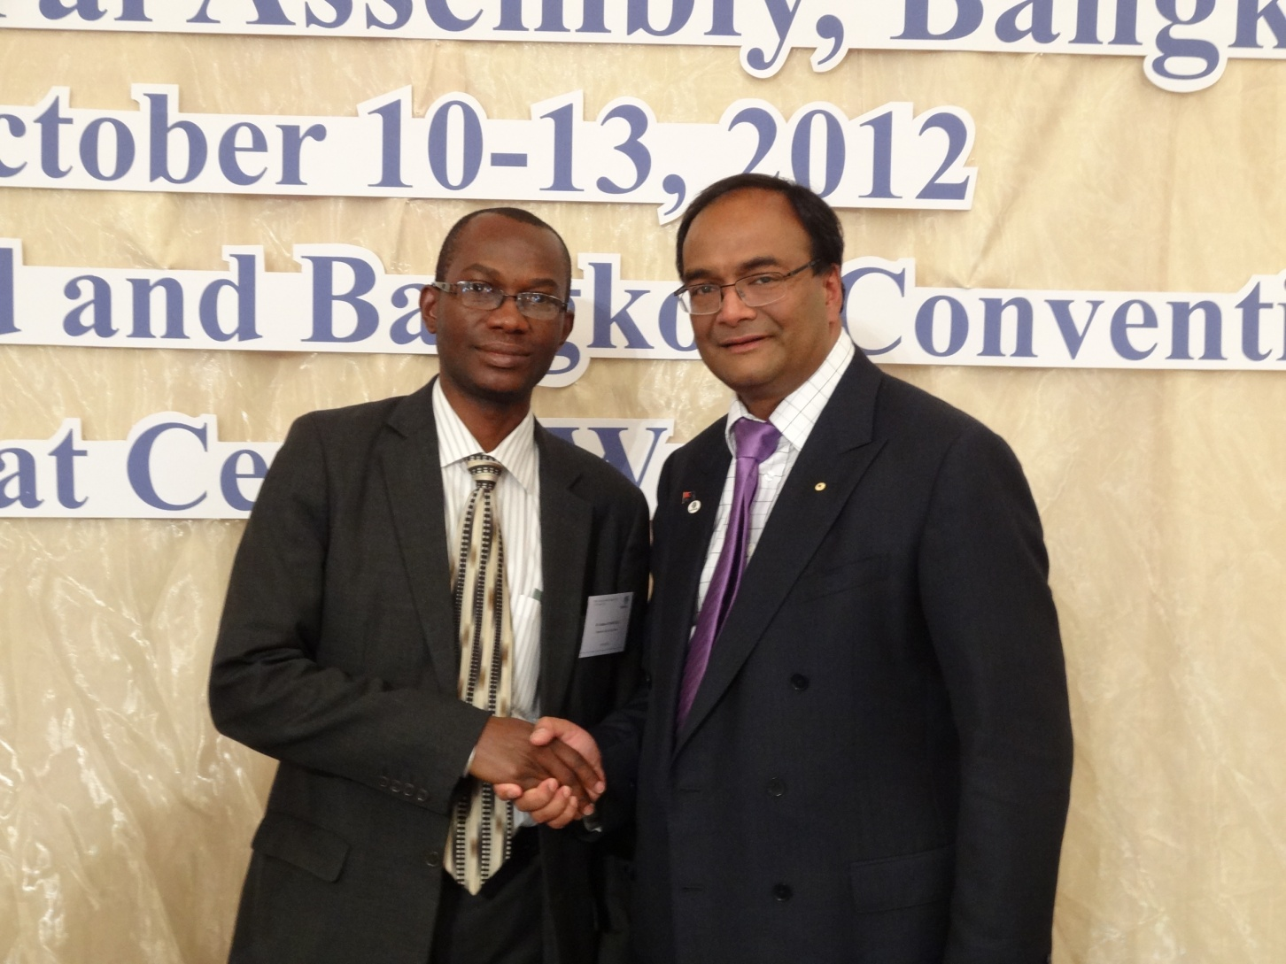
THANK YOU

